Slide 1

SQL HANGMAN
YOU MUST ADD 1 SQL KEYWORD TO THE BOARD
YOU MUST WRITE 1 SQL STATEMENT TO THE OTHER BOARD
ANY MISTAKE WILL COST A LIMB
IF HE SURVIVES, I BRING SNACKS NEXT WEEK

Slide 2
CS50 Lab 7 Andrew Holmes

Slide 3
Today’s Logistics
SQL Commands
SQL Design pointers
Lab – songs!
PSET help ☺

Slide 4
SQL commands
AND JOIN MIN
BETWEEN INSERT OR
COUNT LIKE ORDER BY
GROUP BY LIMIT ROUND
HAVING MAX DISTINCT
SUM WHERE UPDATE
AVG DELETE
AND JOIN MIN
BETWEEN INSERT OR
COUNT LIKE ORDER BY
GROUP BY LIMIT ROUND
HAVING MAX DISTINCT
SUM WHERE UPDATE
AVG DELETE

Slide 5
PSET/Lab notes
Use COUNT as a quick check to suggest your answer is correct
Often easiest to work from inner SELECT out for nested SELECTS
A few notes on JOINs:
Syntax: FROM table1 JOIN table2 on id = table2.id
Better design to use nested selects where possible
JOINs are REQUIRED sometimes, e.g.:
Need to return columns from multiple tables
Need to ORDER BY/impose outer condition on column from different table than the columns you are returning

Slide 6

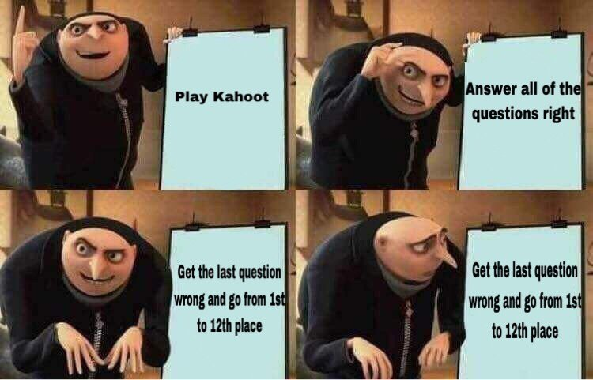
KAHOOOOOOT

Slide 7
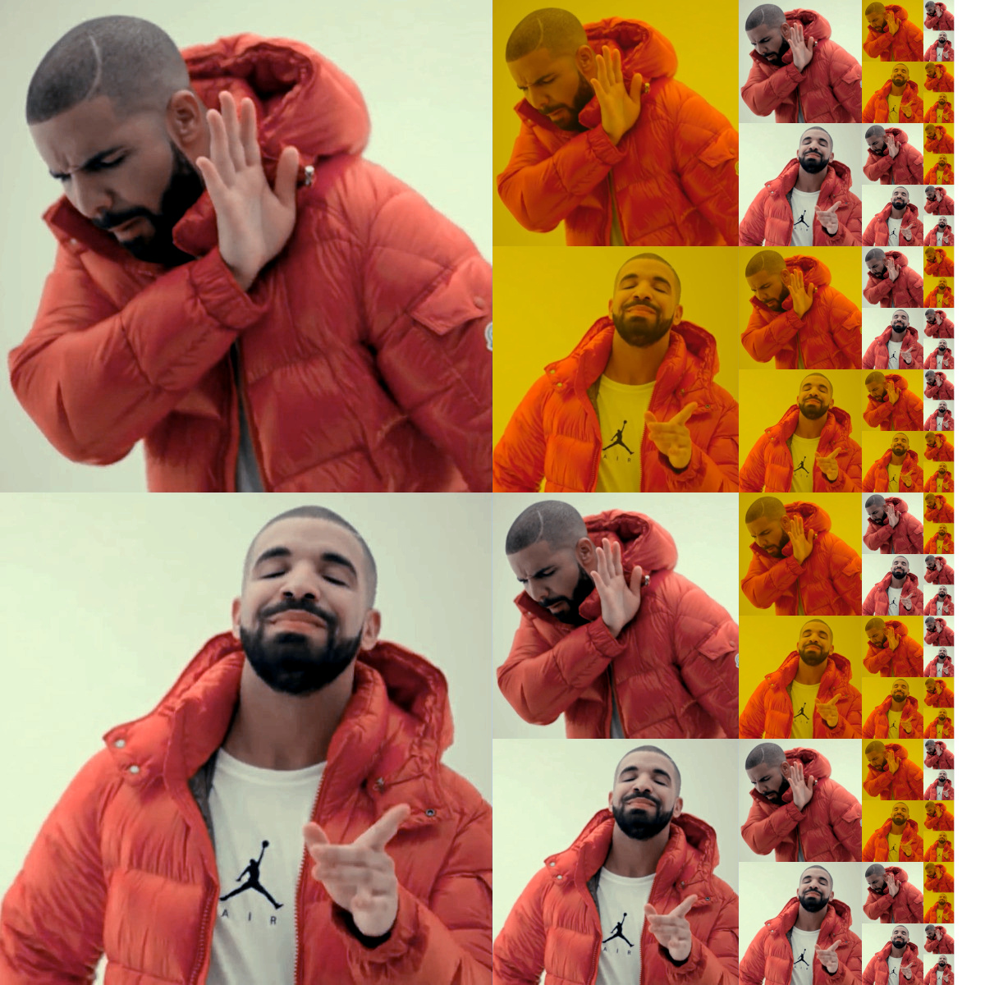
Lab problem: songs
https://cs50.harvard.edu/college/2022/fall/labs/7/

Slide 8

Cya next week :D Web week (my favourite :D)

